Slide 1
Adventure works
Presented By-
Johnson V
Yaswanth Donthagani
Sahil bangar
Aditi mali
Mirza Kashif Raza
Pokharkar suyash

Slide 2
index
1. project overview
2. KPIs Defined
3. KPI Analysis
4. Dashboards
5. Insights
6. Challenges
7. Conclusion

Slide 3
Project Overview - Adventure Works Sales & Profit Analysis
This project focuses on analyzing the Adventure Works sales dataset to understand overall business performance, profitability, and sales trends.
Interactive dashboards were created using Power BI /excel / Tableau to visualize key KPIs such as total sales, profit, profit margin, and sales trends across time periods.
The analysis covers year-wise, quarter-wise, and month-wise performance, along with product-wise and customer-wise insights.
The project aims to support data-driven decision-making by identifying top-performing products, seasonal patterns, and growth opportunities.
The dashboards provide a clear and interactive view of business health, enabling stakeholders to monitor performance and plan strategic actions effectively.

Slide 4
THE TECHNICAL PROCESS
📗 Excel
Data Preparation & Validation
Imported Adventure Works datasets (Sales, Customers, Products, Dates)
Performed initial data cleaning (null checks, formatting, duplicates)
Created basic calculations like total sales, profit, and margins
Validated data consistency before analysis
🗄️ SQL
Data Extraction & KPI Logic
Used SQL queries to filter, join, and aggregate large datasets
Built complex KPIs using JOINS, CTEs, GROUP BY, and Date functions
Analyzed year-wise, month-wise, and product-wise performance
Ensured accurate and scalable data transformation
📊 Power BI / Tableau
Data Modeling & Visualization
Designed a relational data model using fact and dimension tables
Created interactive dashboards with slicers and filters
Visualized KPIs: Total Sales, Profit, Profit Margin, Trends
Enabled drill-down insights for products, customers, and regions

Slide 5
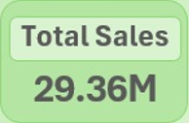
Dashboard : Adventure Works – Sales & Profits KPIs
1️⃣ Total Sales – 29.36M
What it means:
Total revenue generated by Adventure Works across all years and products.
Finding / Insight:
Indicates strong overall business performance.
Shows that the company has achieved nearly 30 million in sales, reflecting good market demand.

Slide 6
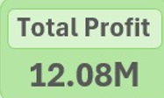
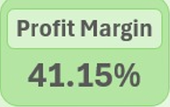
2️⃣ Total Profit – 12.08M
What it means:
Net profit earned after deducting production and operational costs.
Finding / Insight:
Profit is significantly high compared to sales.
Indicates effective cost control and pricing strategy.
3️⃣ Profit Margin – 41.15%
What it means:
Percentage of profit earned from total sales.
Finding / Insight:
A margin above 40% is excellent.
Shows Adventure Works is a highly profitable business with efficient operations.

Slide 7
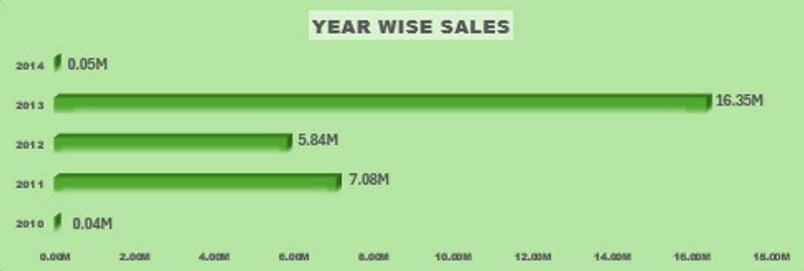

Year-wise Sales (Bar Chart)
What it shows:
Sales trend from 2010 to 2014.
Key Findings:
Sales steadily increase over years.
2013 is the best-performing year (~16.35M).
Indicates consistent growth and expansion.
📌 Business Insight:
👉 Company is scaling well and gaining market traction year after year.

Slide 8
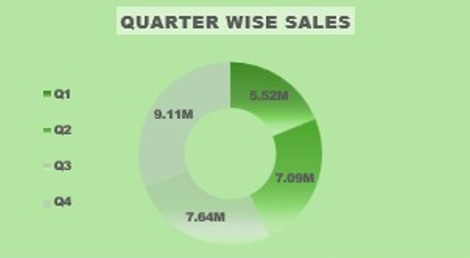
KPI: Quarter-wise Sales Performance
🔹 Overview
This KPI represents total sales distribution across four quarters (Q1–Q4).
It helps in identifying seasonal trends and peak business periods.
🔹 Sales by Quarter (in Millions)
Q1: 5.52M (Lowest)
Q2: 7.09M
Q3: 7.64M
Q4: 9.11M (Highest)
🔹 Key Findings
Sales show a consistent upward trend throughout the year.
Q4 is the best-performing quarter, indicating strong year-end demand.
Q1 underperforms, highlighting scope for improved early-year strategies.
🔹 Business Insight
Focus on replicating Q4 sales strategies in other quarters.
Introduce promotions or campaigns in Q1 to balance annual sales.

Slide 9
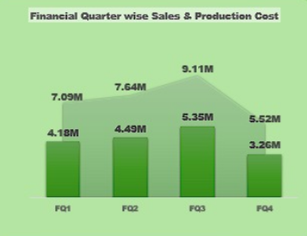
KPI: Financial Quarter-wise Sales & Production Cost
🔹 Overview
This KPI compares sales performance and production cost across financial quarters (FQ1–FQ4).
It helps evaluate cost efficiency and profitability trends over time.
🔹 Quarter-wise Values (in Millions)
FQ1: 4.18M
FQ2: 4.49M
FQ3: 5.35M (Highest)
FQ4: 3.26M (Lowest)
🔹 Key Findings
Sales and production cost increase steadily from FQ1 to FQ3, indicating higher business activity.
FQ3 is the peak quarter, suggesting maximum output and revenue generation.
Sharp decline in FQ4, possibly due to reduced demand, cost optimization, or seasonal slowdown.

Slide 10
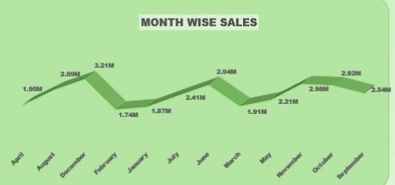
KPI: Month-wise Sales Trend
🔹 Overview
This KPI shows sales performance across different months of the year.
It helps identify seasonal patterns, demand fluctuations, and growth cycles.
🔹 Key Observations
Sales show fluctuations rather than a straight-line trend, indicating seasonality.
Sales dip around February and March, suggesting a temporary slowdown.
Sales improve mid-year (June–July), showing recovery and growth.
Higher sales are observed during October–November, indicating festive or peak demand periods.
🔹 Key Findings
Business experiences seasonal highs and lows throughout the year.
End-of-year months contribute stronger sales performance.
Early-year months may require additional marketing or sales push.

Slide 11
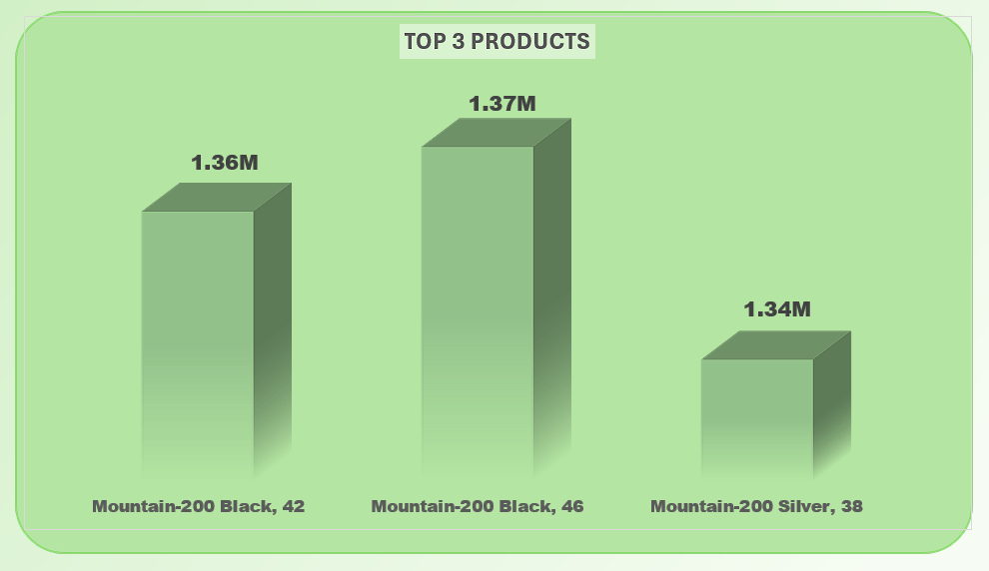
KPI: Top 5 Products by Sales
🔹 Overview
This KPI highlights the top-performing products based on total sales value.
It helps identify high-revenue products and supports product, inventory, and marketing decisions.
🔹 Top Products & Sales (in Millions)
Mountain-200 Black, 46: 1.37M (Highest selling product)
Mountain-200 Black, 42: 1.36M
Mountain-200 Silver, 38: 1.34M
🔹 Key Findings
Mountain-200 series dominates sales, indicating strong customer preference.
Black color variants perform slightly better than Silver, suggesting color-based demand.
Sales values are very close, showing consistent performance across top products.

Slide 12
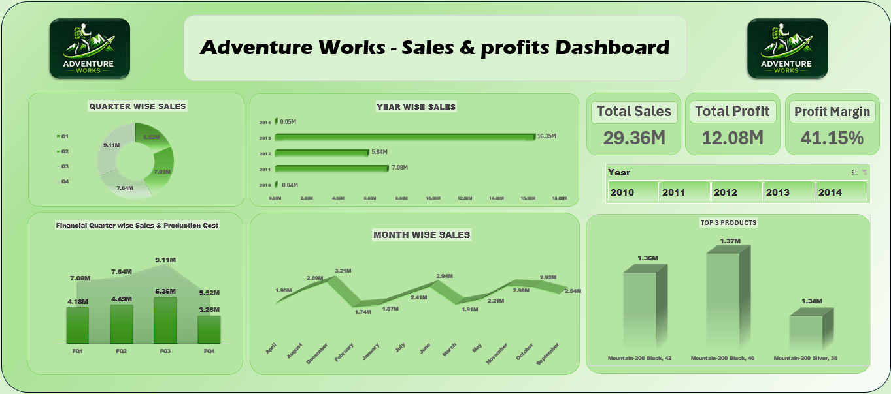
EXCEL DASHBOARD-

Slide 13
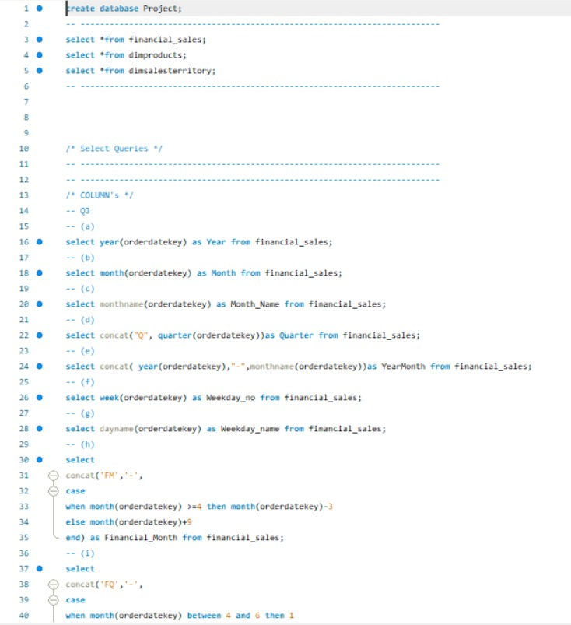
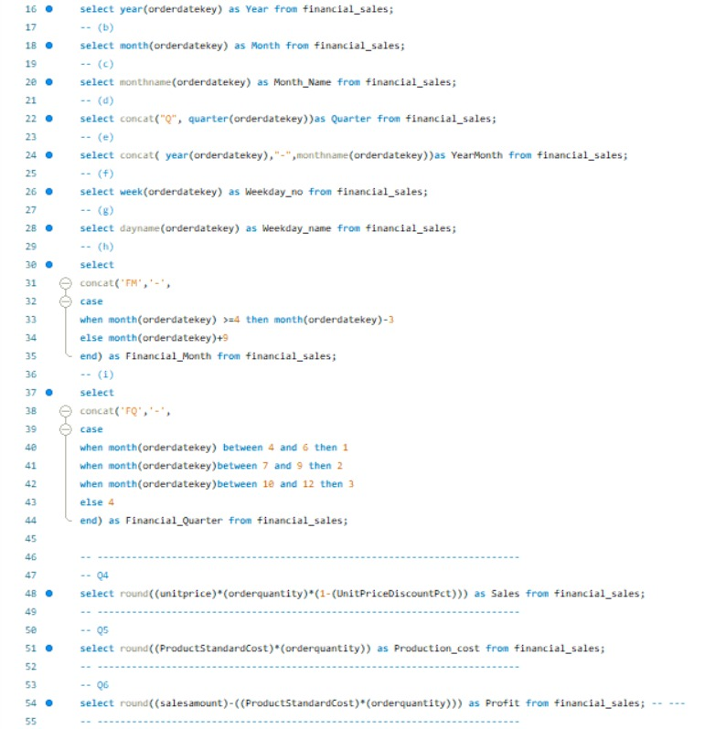
Sql Query-

Slide 14
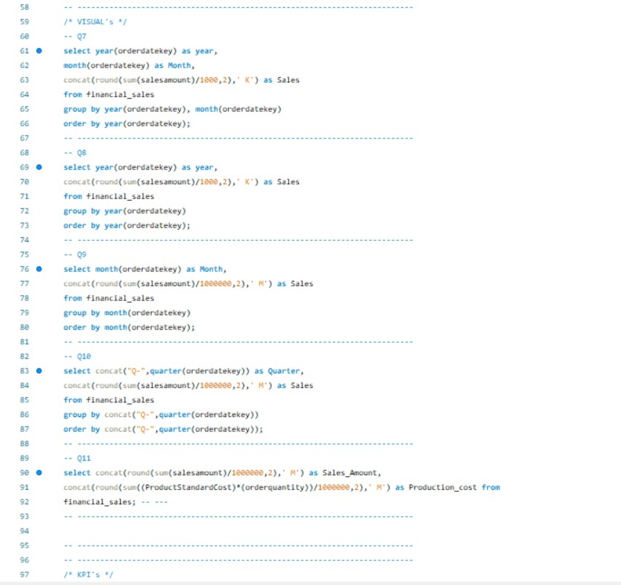
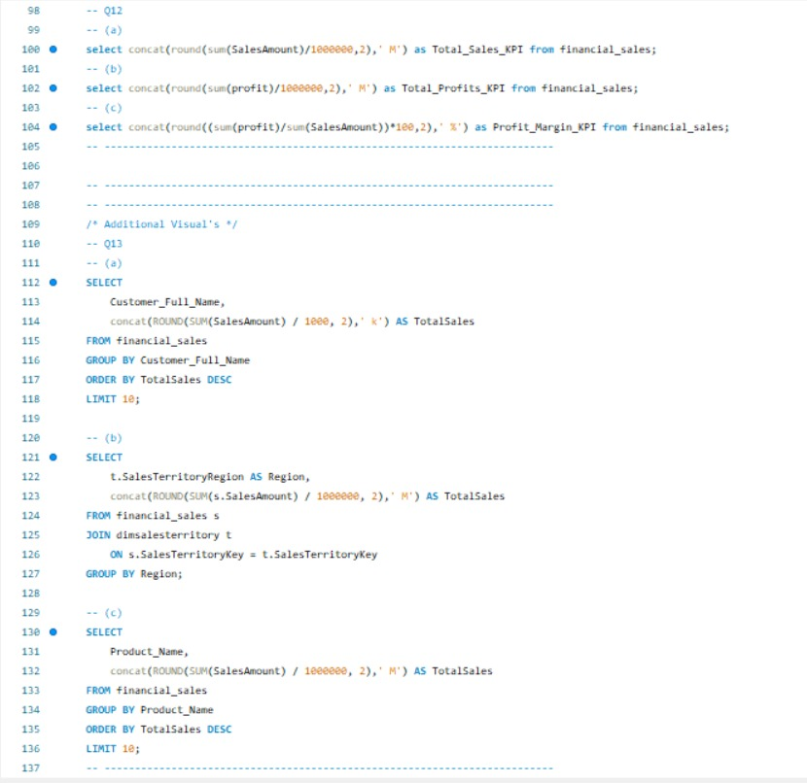

Slide 15
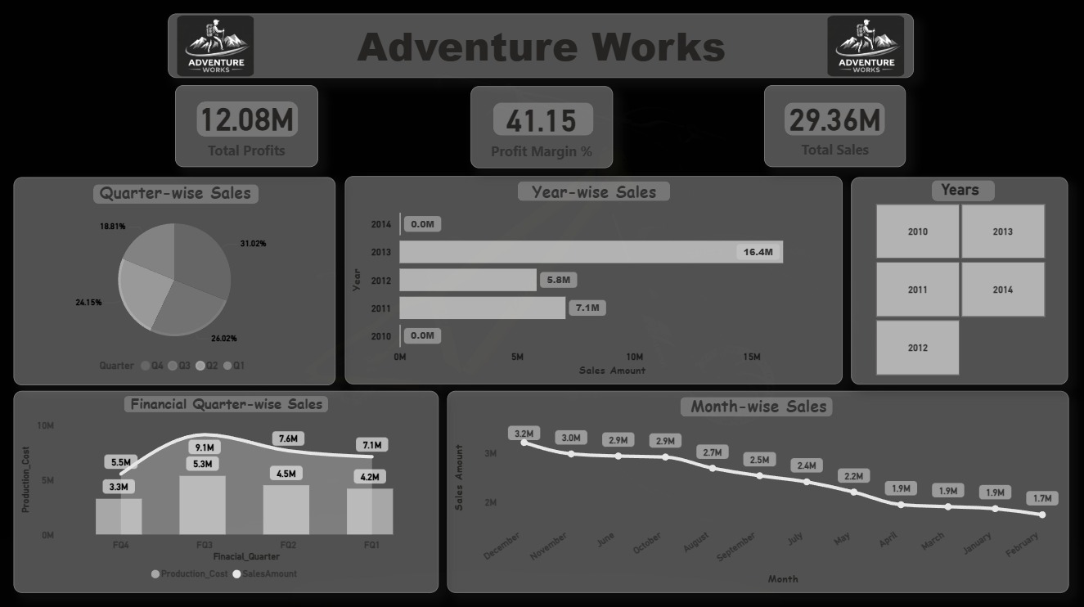
POWERBI DASHBOARD-

Slide 16
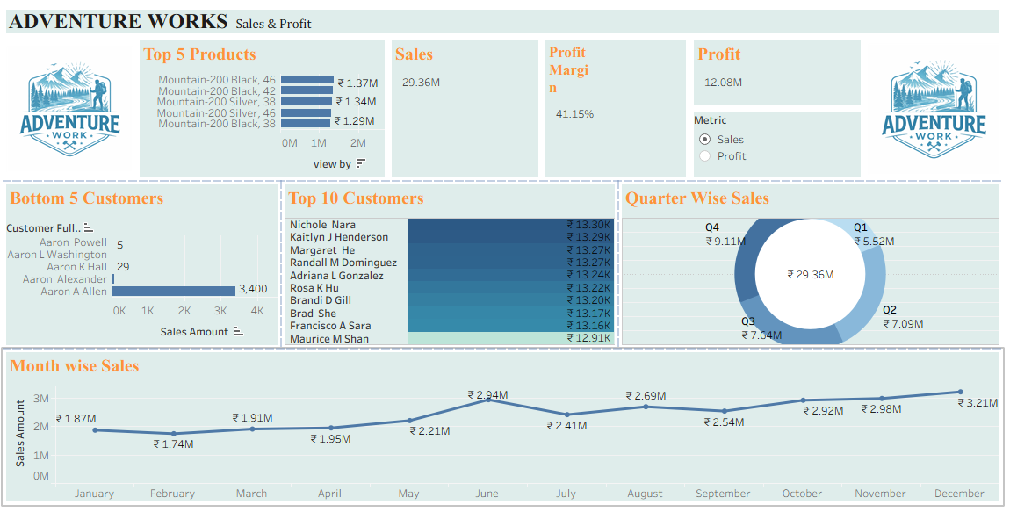
TABLEAU DASHBOARD-

Slide 17
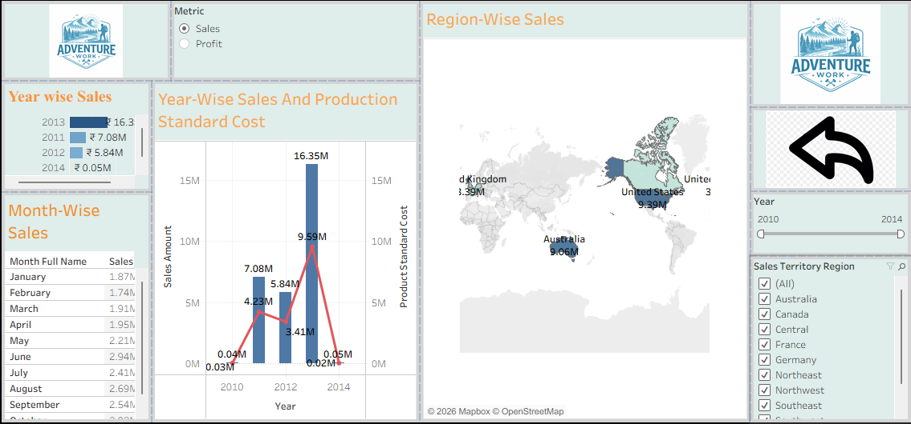

Slide 18
Conclusion – Adventure Works Sales & Profit Analysis
Adventure Works shows strong financial performance with 29.36M total sales, 12.08M profit, and a high profit margin of 41.15%.
Sales demonstrate consistent year-on-year growth, with 2014 as the highest-performing year, indicating successful business expansion.
Quarter 4 contributes the maximum revenue, while Quarter 1 shows the lowest sales, highlighting seasonal demand patterns.
The Mountain-200 product series is the top revenue driver, proving that a few key products generate most sales.
Customer revenue is well-distributed, reducing dependency risk and supporting sustainable growth.

Slide 19
Challenges & How They Were Overcome
Resolved data accuracy and consistency problems using SQL queries and Excel-based data cleaning
Implemented profit and margin calculations through SQL calculated fields
Addressed tool integration issues by ensuring consistent primary and foreign keys across platforms
Improved query efficiency by applying aggregation techniques and indexing
Enhanced dashboard usability by creating clean, uniform, and simplified visual designs

Slide 20
THANK YOU…

